Slide 1
Operation Emily
Photos submitted by David Martin

Slide 2
Operation Emily took place from 1958 until the Thor rockets were scrapped in the early sixties.
Personnel were provided by 13 Field Survey Squadron RE.
The task was to provide surveys for the establishment of 20 Thor ICBM bases in eastern England with four
HQ bases at RAF Feltwell, RAF Hemswell, RAF Driffield and RAF North Luffenham.
Each HQ had four sub stations all on existing RAF stations.
The task included Reconnaissance, pillar building, Macca base measurement, triangulation and astronomy.
The majority of junior surveyors were taken from the ranks of National Servicemen

Slide 3
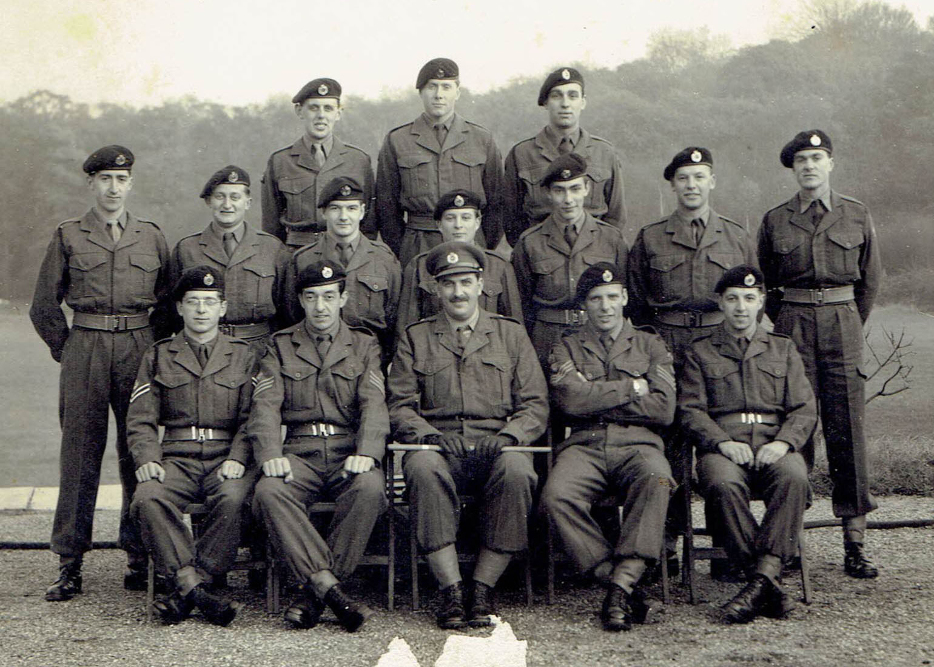
The team c 1958
Front Row L-R
Chris Everett, Pete Riffle, Capt John Henshaw,
Bob Louden, ?.
Middle Row L-R
Nev Borley, ?, ? Frank ?, Albie Field, Pete Attwood, John Boyd.
Rear row L-R
?, David Martin, ?
Any help with names would be greatly appreciated.

Slide 4
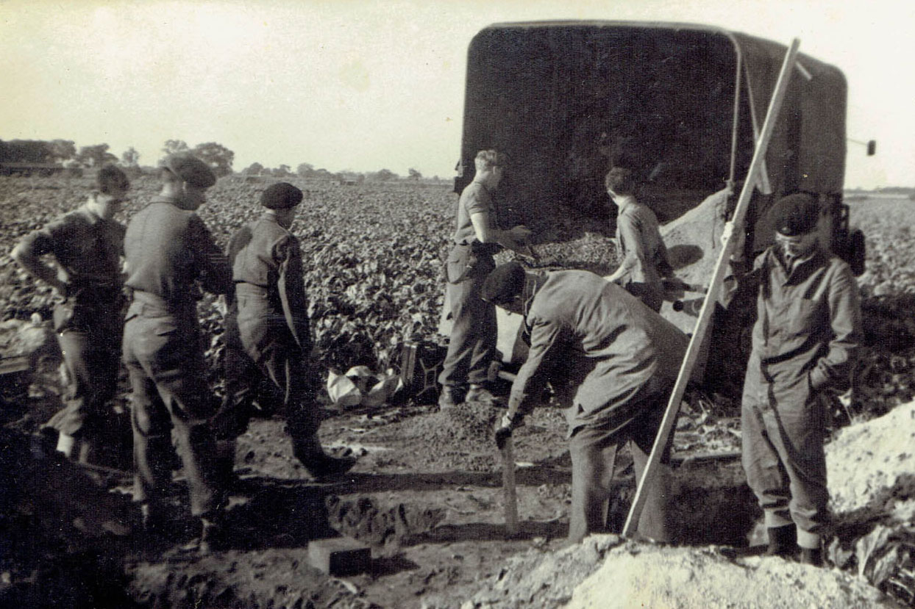
Each site required the building of two OS pillars about 1,000 feet apart to form a base line for later work.
The picture above shows early stages of such a pillar with pegs being driven to transfer the buried mark
To the surface mark and thereafter to the top of the pillar.

Slide 5
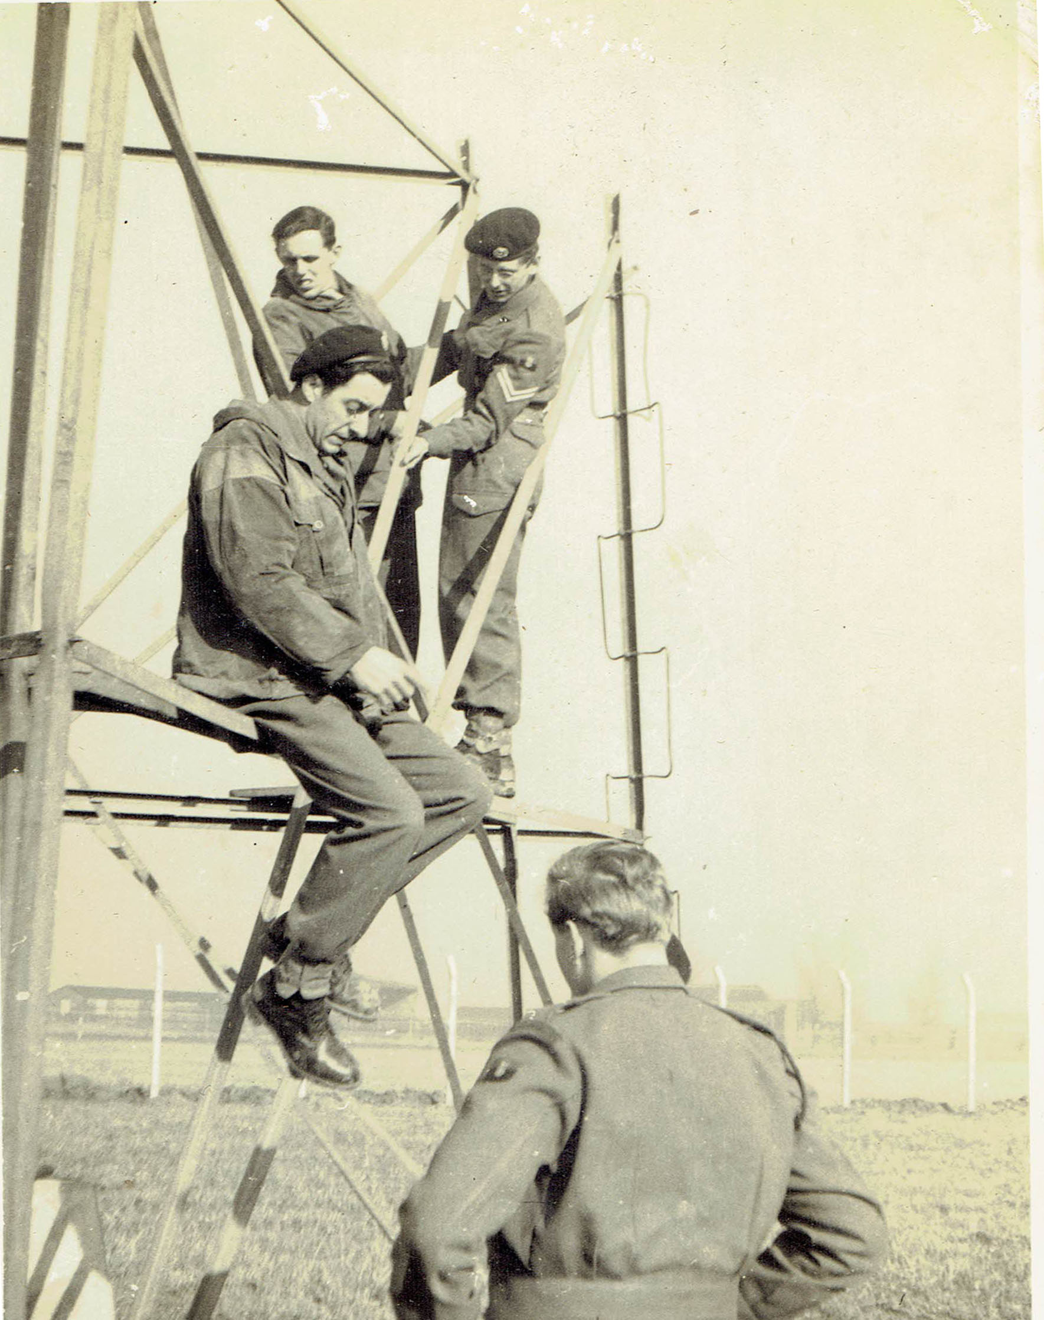
The areas where the sites were in Eastern England tended to be flat and in consequence it was sometimes
Necessary to build Bilby towers on one of the baseline pillars and for the majority of the
OS triangulation stations used were elevated. We used several Cathedrals during the task , many church towers and several water towers.
Cathedrals used included Ely, Lincoln, Beverley and York.
The next few slides show aspects of tower building.

Slide 6
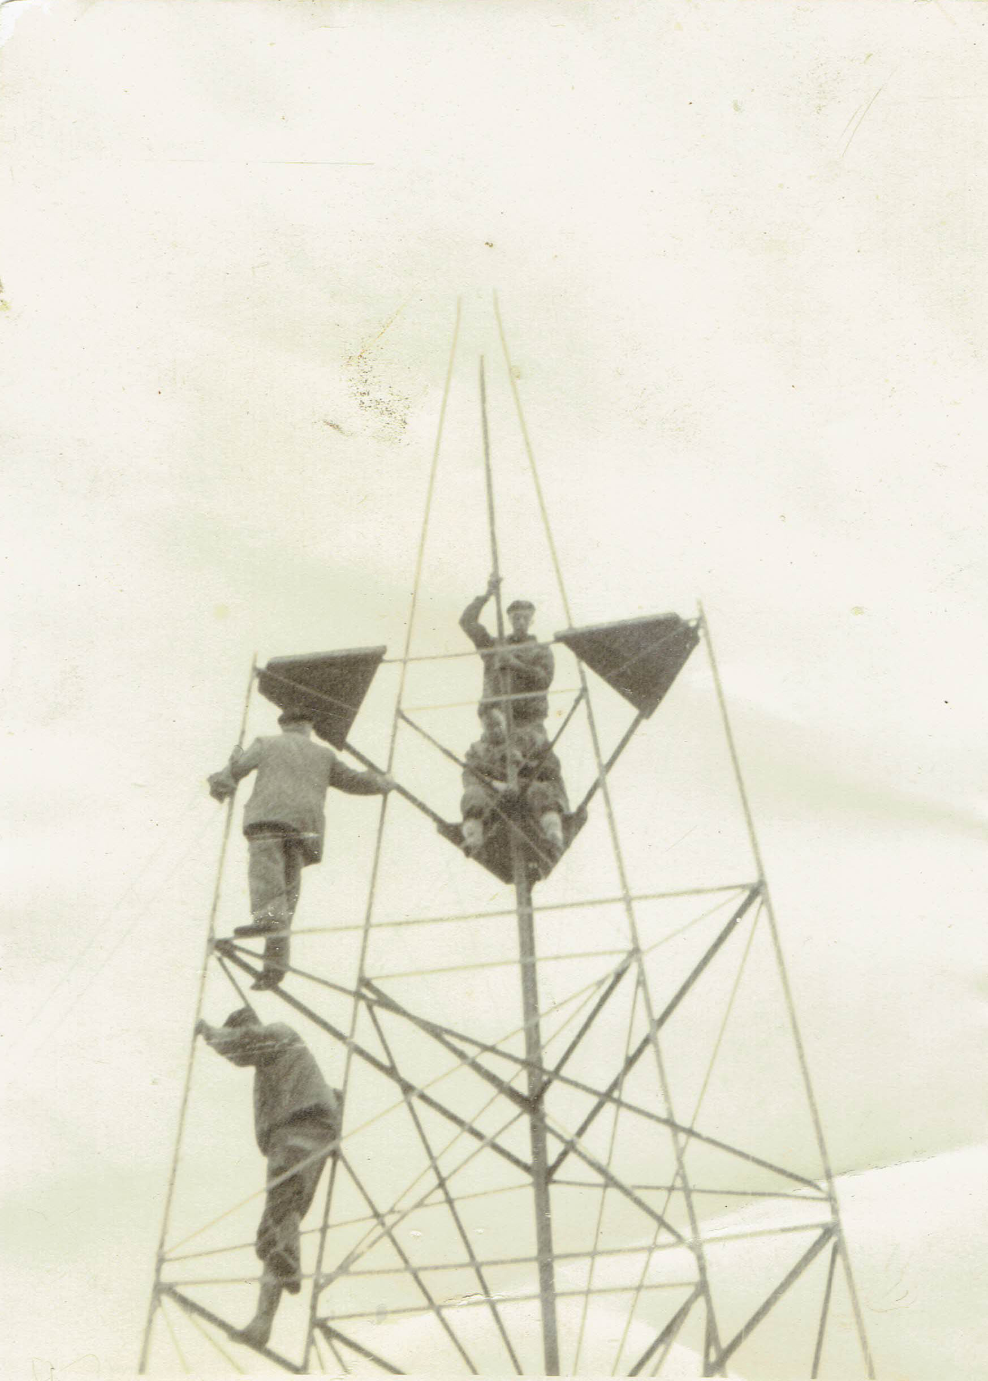
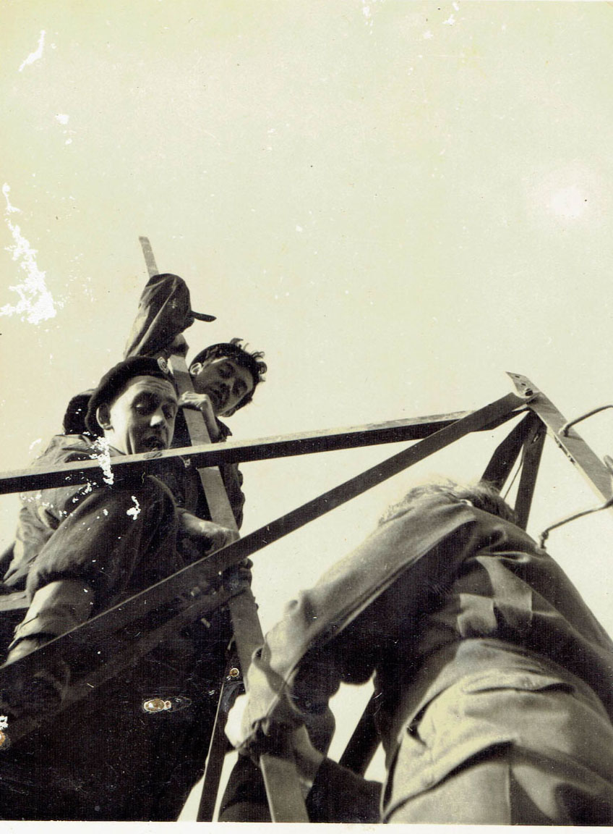

Slide 7
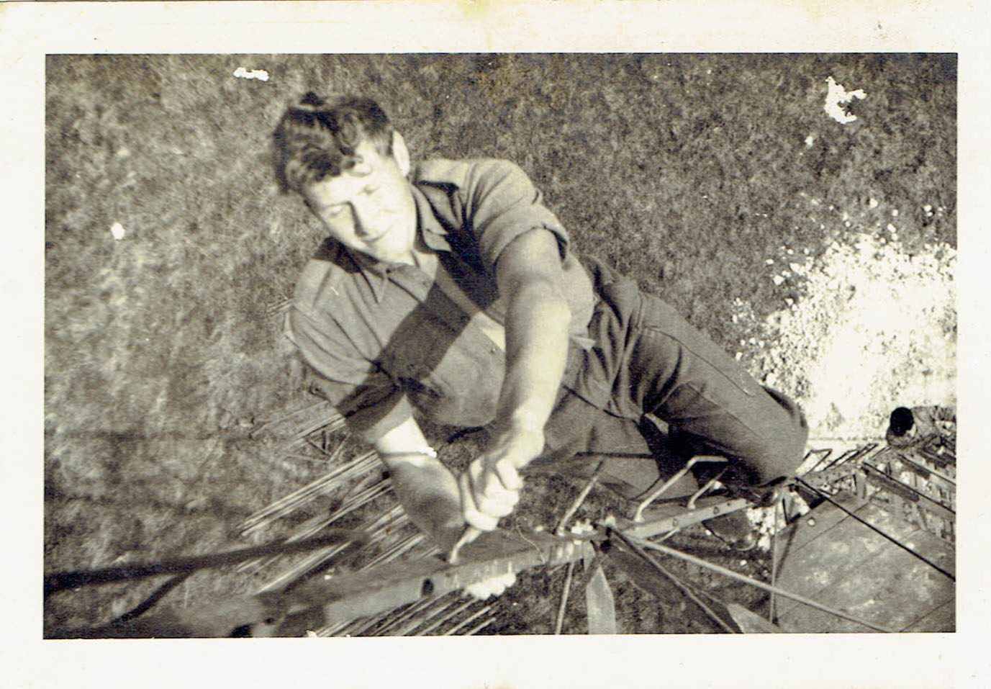

Slide 8
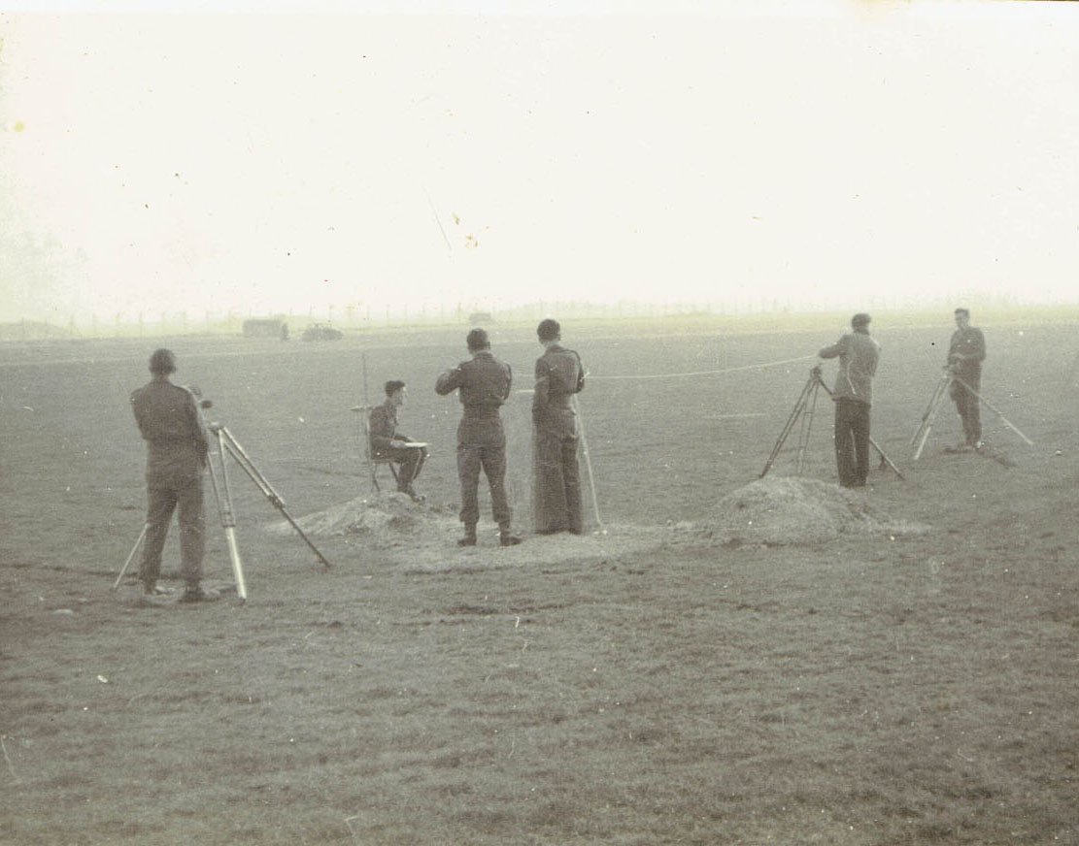
The picture on the left and the next slide shows Macca Base measurement in progress. It appears to me that the measurement taking place is a final short bay using a 6 metre invar tape, main bays were 24 metres.
You can see clearly the straining tripods with the weight hanging below.

Slide 9
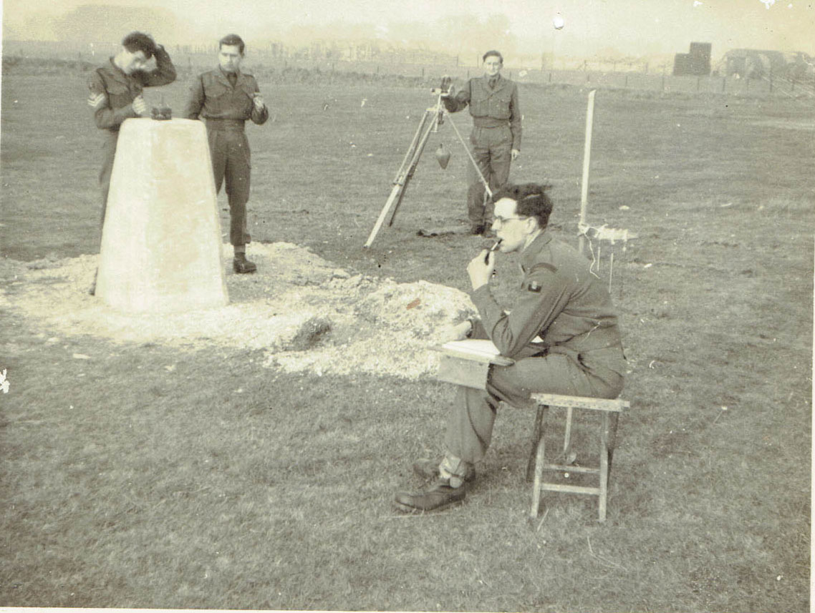

Slide 10
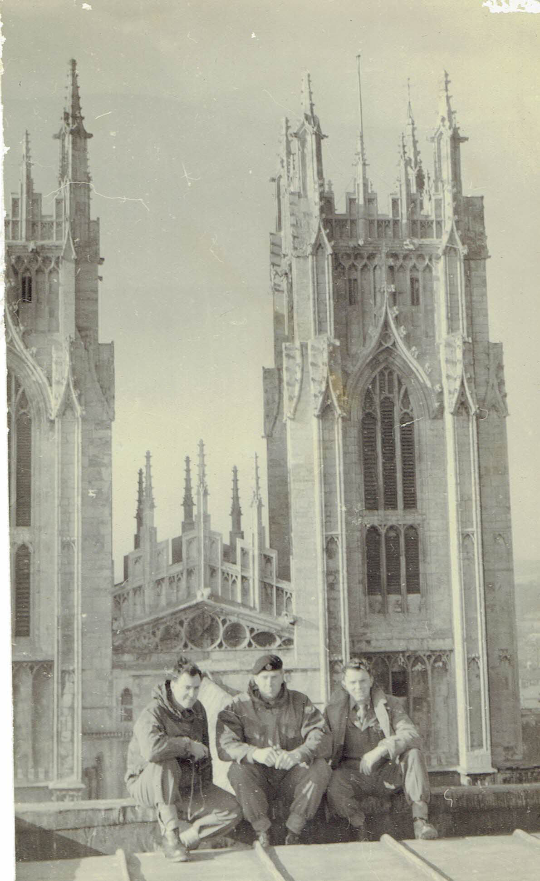
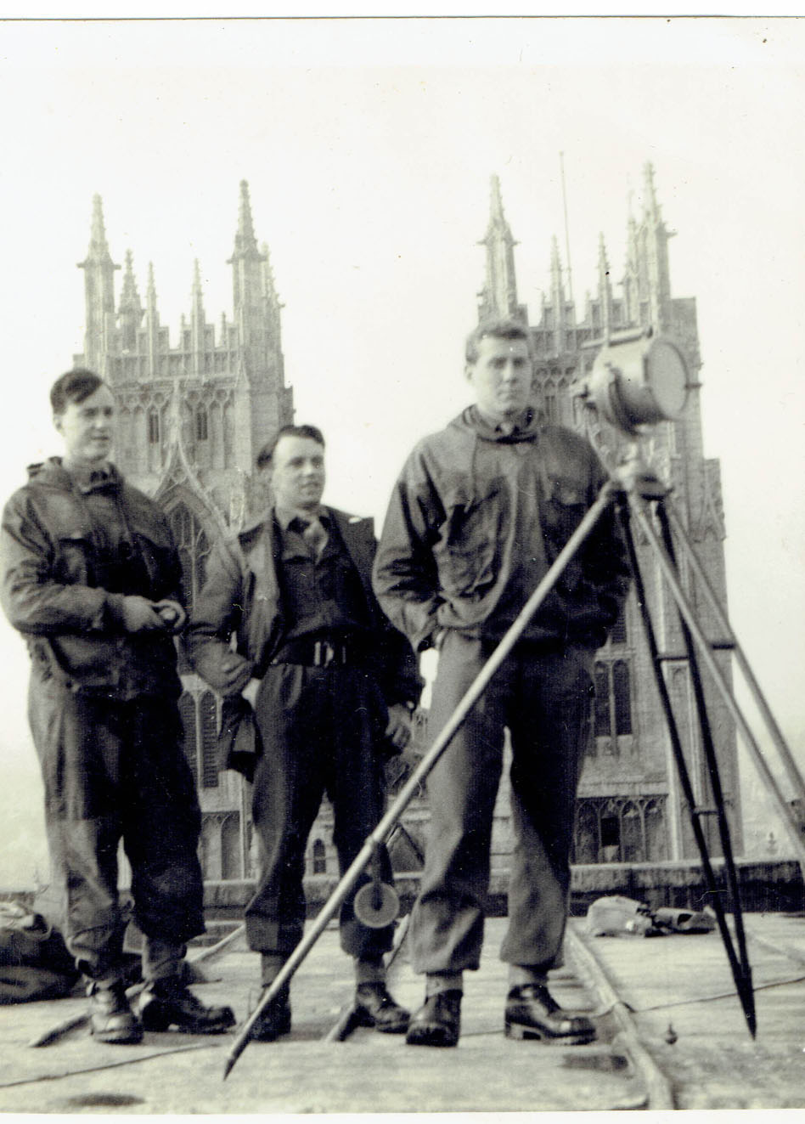
The left hand photo shows Bud Moon & David Martin. I believe it is on Ely Cathedral
But cannot be sure. On the right on the same roof David is lightkeeping.

Slide 11
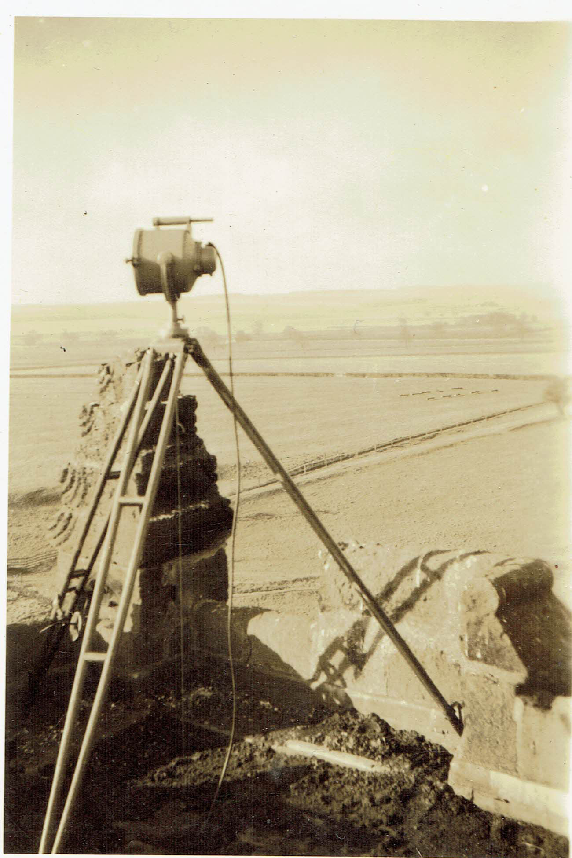
The photo on the left shows a beacon lamp set up over a triangulation mark in the corner of the roof of a church tower.

Slide 12
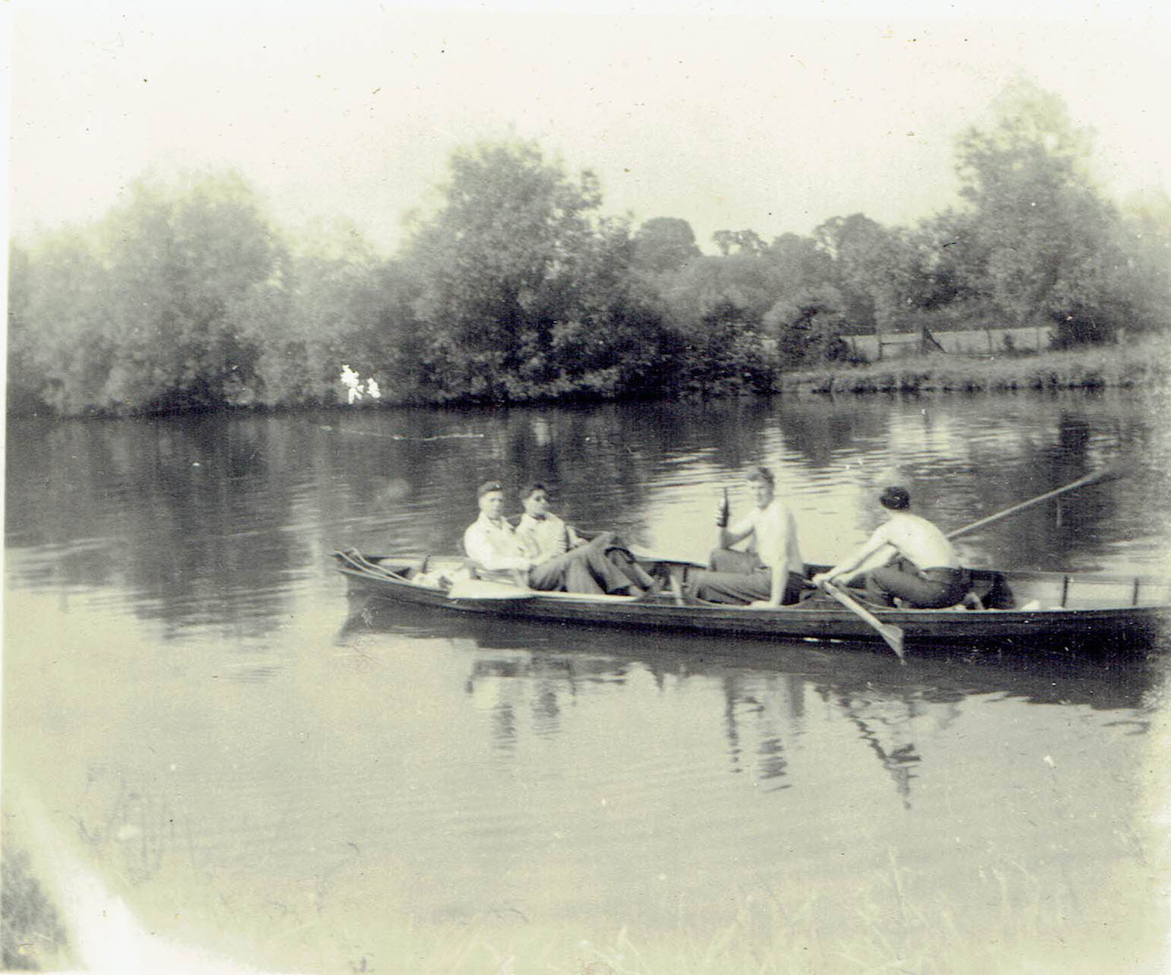
Another photo from David Martin.
It looks flat enough to be in eastern England!
David with a time honoured drink handy!

Slide 13
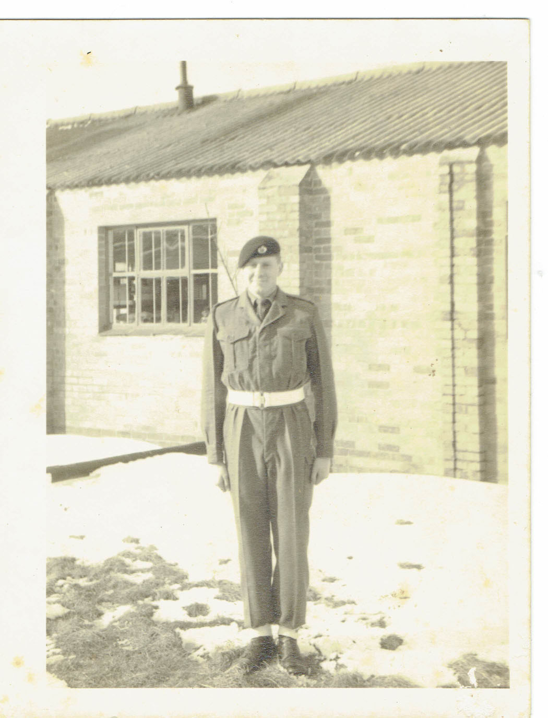
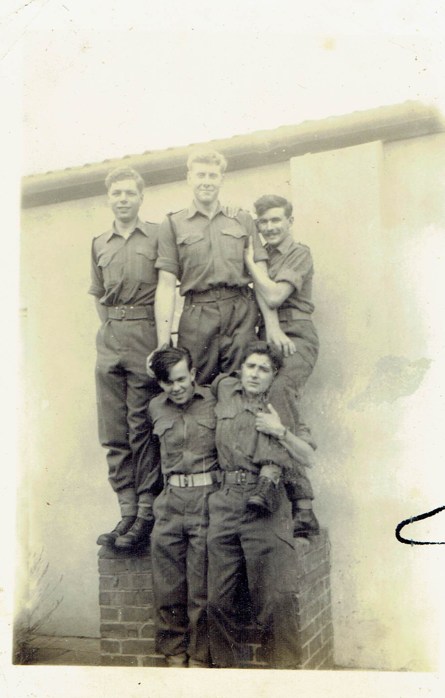
Not from Op Emily but a couple taken at SMS. Dave Martin on the left and top of the pile on the right

